Slide 1


Oral Communication Skills B
(CELEN082)
Lesson 10.1

Slide 2
Lesson aims and objectives
Become more familiar with the marking descriptors for the Final Presentation. Increase awareness of the content and formatting requirements of reference list entries. Practise proofreading references to check them for accuracy. Reflect on PowerPoint design and presentation content by asking the tutor questions about the feedback to the PowerPoint Slides task.

Slide 3

Final Presentation
marking criteria

Slide 4

Final Presentation marking criteria
In the Final Presentation, you will be assessed based on the following four criteria:
Task achievement (40%)
Delivery (40%)
Visual aids (10%)
(Mechanics of) Referencing (10%)
Work in groups. For each criteria, what do you think you have to do to get a good score?

Slide 5
Final Presentation marking criteria
Task achievement (40%)
Delivery (40%)
Visual aids (10%)
(Mechanics of) Referencing (10%)
Introduction:
attention grabber, title and overview
Non-verbal communication:
eye contact and gestures
PowerPoint design:
headings match the overview; consistent and appropriate design style
Accurate citations:
spelling/ punctuation, and position on slides
Problem:
explanation, causes and
significance
Pronunciation & speech features:
pronunciation of individual words; sentence stress; intonation; chunking and pausing; pacing; volume
PowerPoint text:
text amount; style & size; consistency and accuracy
Accurate reference list:
formatting style, alphabetical order and matching citations
Two solutions:
clear explanation
Evaluation of solutions:
balanced (strengths and weaknesses) and supported
Language use
(spoken only):
grammar and lexis; signposting, and register
Conclusion:
summary and clincher
Review CELEN082 Final Presentation Descriptors 2024-2025 document from the CELE Assessment Moodle page.

Slide 6
Final Presentation marking criteria
Today, we will focus on three of the marking criteria: Task achievement, Visual aids and (Mechanics of) Referencing.
Work in groups.
 | Score 10 | Score 4
Task achievement (introduction)
Task achievement (problem)
Task achievement (solutions)
Task achievement (evaluation)
Task achievement (conclusion)
Visual aids (design)
Visual aids (text)
Referencing (citations)
Referencing (reference list)
Option 1:
Your tutor will give you a set of cut-outs, some describing score 4 and some describing score 10 for sections of the marking criteria. Match them to the correct criteria.
Option 2:
Your tutor will give you a handout containing certain sections of the marking criteria. Some of the words are missing. Try to fill in the blank spaces.
Notes:
Note for the tutor: Choose one of the options and delete the other one from the slide.

Slide 7
Final Presentation marking criteria
 | Score 10 | Score 4
Task achievement (introduction) | highly effective and engaging introduction containing all expected elements | adequate introduction. It might be superficial/mechanical. The overview is present, but the attention grabber might be missing
Task achievement (problem) | highly effective explanation of the problem comprehensively stating its causes and significance | adequate explanation of the problem attempting to state its causes and significance, but may lack some clarity or be superficial
Task achievement (solutions) | highly effective explanation of relevant solutions | adequate explanation of relevant solutions, but may lack clarity or be superficial
Task achievement (evaluation) | highly effective evaluation of the solutions. Evaluation shows criticality | adequate evaluation of the solutions, but may lack criticality and/or depth
Task achievement (conclusion) | highly effective and engaging conclusion containing all expected elements | adequate conclusion. It might be superficial/mechanical. The summary is present, but the clincher might be missing

Slide 8
Final Presentation marking criteria
 | Score 10 | Score 4
Visual aids (design) | highly effective PowerPoint design which is appropriate and consistent throughout. No distractions | adequate attempt at PowerPoint design. Some appropriateness and/or consistency issues. Distracting at times
Visual aids (text) | highly effective use of PowerPoint text which is appropriate and consistent throughout. No distractions | adequate attempt at using PowerPoint. Some appropriateness and/or consistency issues. Distracting at times
Referencing (citations) | accurate use of citations throughout | one or two citations may be missing and/or there are frequent naming or formatting errors
Referencing (reference list) | reference list is entirely accurately written and formatted. Matches citations | reference list contains frequent errors in accuracy and formatting, and/or does not match citations on two occasions

Slide 9
Proofread the references

Slide 10
Reference list: Guidelines
Work with your group to complete the tasks below.
Identify at least six elements that OFTEN need to be included in reference list entries.
Identify at least one element that should ALWAYS be included in reference list entries.

Slide 11
Reference list: Guidelines
Answers:
The author’s surname and initials
The year of a source’s publication
The title of the work itself
The name and location of the publisher (for books)
The name of the wider source
e.g. journal name
newspaper name
The edition and issue numbers (for journal articles)
The page numbers (for journal articles)
A URL link (for online sources)
The date when a source was last accessed (for online sources)
← This is not always known.
← This should ALWAYS be included.
Use the CELE Citation and Referencing Guide for more guidance on how to write the reference for a source.

Slide 12

Reference list: Practice
Work with a partner. Using the ‘CELE Citation and Referencing Guide’ fill in the table from the OCSb Workbook to help you proofread your partner’s references (the ones posted to the class Teams or the ones from their PPT slides).
Ask your partner to show you the original source if you are unsure of the source type.
Ask your tutor for help if you are unsure.
 | Source type | Guide page number | All elements included | Correct formatting
Source 1 (e.g.) | book | p.10 | No - publisher name missing | No - book title should be in italics
Source 2
Source 3
When you finish, …
give your partner feedback on their references.
use your partner’s feedback to improve your references.
check all the references on your presentation slides.

Slide 13
Reflection and review

Slide 14
Reflection and review
Review the feedback your tutor gave you on the PowerPoint Slides assessment and complete the following tasks:
1. Use the checklist from your OCSb Workbook (Lesson 10.1 section) to reflect on your presentation (not just the PPT!).
2. Compare your checklist with a partner and identify common strengths and common areas for improvement.
3. Make improvements to your slides/ presentation based on your tutor’s feedback and the checklist.
This is an opportunity for you to ask your tutor any questions about your presentation.

Slide 15
Other

Slide 16
Practice presentation schedule
 | DAY | TIME | STUDENTS
WEEK 11 | Lesson 11.1 | :00 – :50
 |  | :00 – :50
 | Lesson 11.2 | :00 – :50
WEEK 12 | Lesson 12.1 | :00 – :50
 |  | :00 – :50
 | Lesson 12.2 | :00 – :50
Students only need to attend their scheduled session. However, they can also attend other sessions if they choose to. Please be on time!

Slide 17
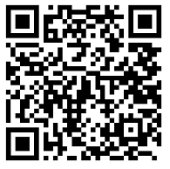
Student Evaluation of the Module (SEM)
https://bluecastle-cn-surveys.nottingham.ac.uk
Provide feedback on the module.
This refers to the organisation and content of the course (not the teacher).
Note: SEMs are important for future course development! They are compulsory!

Slide 18
Homework
Due | Task
Lesson 10.2 | Review your PPT slides and prepare any questions you might have about the Final Presentation. Prepare a script for one of your presentation sections and bring it to class. ​
Weeks 11 & 12 | Prepare for your practice presentation in Week 11 or 12.

Slide 19
Oral Communication Skills B
(CELEN082)
Lesson 10.2

Slide 20
Lesson aims and objectives
Review and practise the pronunciation skills of sentence stress, intonation and chunking and pausing. Have the opportunity to ask any final questions about the Final Presentation.

Slide 21
Pronunciation review
(sentence stress)

Slide 22
Pronunciation review: Sentence stress
Analyse the four presentation extracts below and match them to their functions.
1 | So, the topic of my presentation today is ways to solve smartphone addiction in American teenagers.
2 | I’ve divided my presentation into three parts. First, I’ll introduce what smartphone addiction is and its symptoms.
3 | Research is discovering that smartphone addiction is having an extremely negative impact on teenagers’ lives.
4 | Although if used effectively smartphones can help people save time, when teenagers use them they often waste time.
d
a) the speaker is presenting two contrasting ideas
c
b) the speaker is presenting a strong opinion
c) the speaker is telling the audience about the structure of their presentation
b
d) the speaker is presenting a new and important idea to the audience
a

Slide 23
Pronunciation review: Sentence stress
Thinking about the function of the information being presented, predict which words in each extract the speaker will stress.
Hint: We studied this in Lesson 2.1.
1 | So, the topic of my presentation today is ways to solve smartphone addiction in American teenagers.
2 | I’ve divided my presentation into three parts. First, I’ll introduce what smartphone addiction is and its symptoms.
3 | Research is discovering that smartphone addiction is having an extremely negative impact on teenagers’ lives.
4 | Although if used effectively smartphones can help people save time, when teenagers use them they often waste time.
d) the speaker is presenting a new and important idea to the audience
c) the speaker is telling the audience about the structure of their presentation
b) the speaker is presenting a strong opinion
a) the speaker is presenting two contrasting ideas
Practise saying the extracts with your predicted sentence stress.

Slide 24

Pronunciation review: Sentence stress
Listen and check your predictions.
Then, practise saying the sentences using the same stress as the speaker.
1 | So, the topic of my presentation today is ways to solve smartphone addiction in American teenagers.
2 | I’ve divided my presentation into three parts. First, I’ll introduce what smartphone addiction is and its symptoms.
3 | Research is discovering that smartphone addiction is having an extremely negative impact on teenagers’ lives.
4 | Although if used effectively smartphones can help people save time, when teenagers use them they often waste time.

Slide 25
Pronunciation review
(intonation)

Slide 26
Pronunciation review: Intonation
Analyse the three presentation extracts below and match them to their functions.
1 | Although if used effectively smartphones can help people save time, when teenagers use them they often waste time.
2 | Instead of using smartphones to feel pleasure, try to do some moderate to high-intensity exercise, such as brisk walking, cycling, or running.
3 | The use of smartphones can have a terrible impact on the mental health of teenagers.
b
a) the speaker is presenting a list of similar items
a
b) the speaker is presenting two contrasting ideas
c) the speaker is presenting their emotional attitude about an idea
c

Slide 27
Pronunciation review: Intonation
Thinking about the function of the information being presented, predict which intonation patterns the speaker will use. Add a rising intonation  or a falling intonation  to the spaces in each sentence.
Hint: We studied this in Lesson 3.1.
1 | Although if used effectively smartphones can help people save time, when teenagers use them they often waste time.
2 | Instead of using smartphones to feel pleasure, try to do some moderate to high-intensity exercise, such as brisk walking, cycling, or running.
3 | The use of smartphones can have a terrible impact on the mental health of teenagers.
Practise saying the extracts with your predicted intonation patterns.

Slide 28
Pronunciation review: Intonation
Listen and check your predictions.
Then, practise saying the sentences using the same intonation as the speaker.

1 | Although if used effectively smartphones can help people save time, when teenagers use them they often waste time.
2 | Instead of using smartphones to feel pleasure, try to do some moderate to high-intensity exercise, such as brisk walking, cycling, or running.
3 | The use of smartphones can have a terrible impact on the mental health of teenagers.






Slide 29
Pronunciation review
(chunking and pausing)

Slide 30
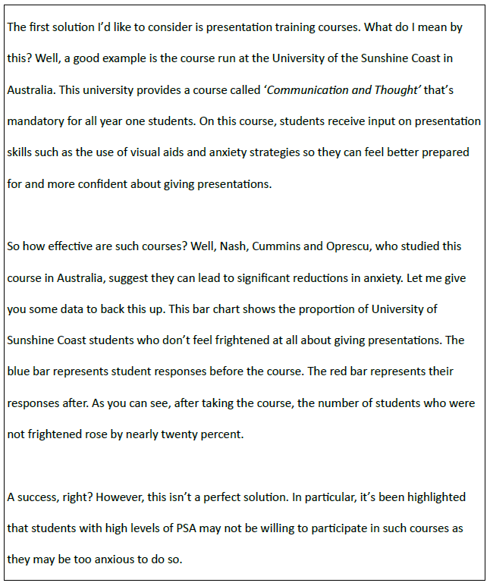
Pronunciation review: Chunking and pausing
Analyse the extract from a presentation about anxiety when delivery oral presentations and predict where the speaker will pause to break their speech into natural chunks.
Add / to the places where you think the speaker will pause.
Work in pairs. Practise saying the extract with your predicted pausing patterns.
Hint: We studied this in Lesson 4.1.

Slide 31
Pronunciation review: Chunking and pausing
Listen and check your predictions.

Slide 32
Pronunciation review: Chunking and pausing
Practise saying the sentences using the same chunking and pausing as the speaker.
The first solution I’d like to consider / is / presentation / training courses. / What do I mean by this? / Well, / a good example of the course* /… a good example is the course / run at the University of the Sunshine Coast in Australia. / This university provides a course called ‘Communication and Thought’ / that’s mandatory for all year one students. / On this course, / students receive input on presentation skills / such as / the use of visual aids / and anxiety strategies / so they can feel better prepared and / more confident about giving presentations. /
So / how effective are such courses? / Well, / Nash, Cummins and Oprescu, / who studied this course in Australia, / suggest they can lead to significant reductions in anxiety. / Let me give you some data to back this up. / This bar chart / shows the proportion of the University of the Sunshine Coast students / who don’t feel frightened at all about giving presentations. / The blue bar represents student responses / before the course. / The red bar / represents their responses / after. / As you can see, / after taking the course, / the number of students who were not frightened / rose / by nearly twenty percent. /
A success, right? / However, / this isn’t a perfect solution. / In particular, it’s been highlighted that students with high levels of PSA / may not be willing to participate in such courses / as they may be / too anxious / to do so. /
*speaker error

Slide 33
Assessed presentation
(exam procedure)

Slide 34
Assessed presentation: Exam procedure
On presentation day:
Arrive at the room at least 15 minutes before the start time.
Bring printed copies of your slides (4 slides per A4 page).
Bring your presentation PPT on a USB. Have a back-up option too (e.g. send a copy to your email).
Bring your student ID card.
If you don’t follow the above rules you will not be allowed to present (= fail).
You must also submit your presentation slides via Moodle on the day of your presentation. This is to check for academic misconduct. If you don’t a flat 10% penalty will be applied to your final score.

Slide 35
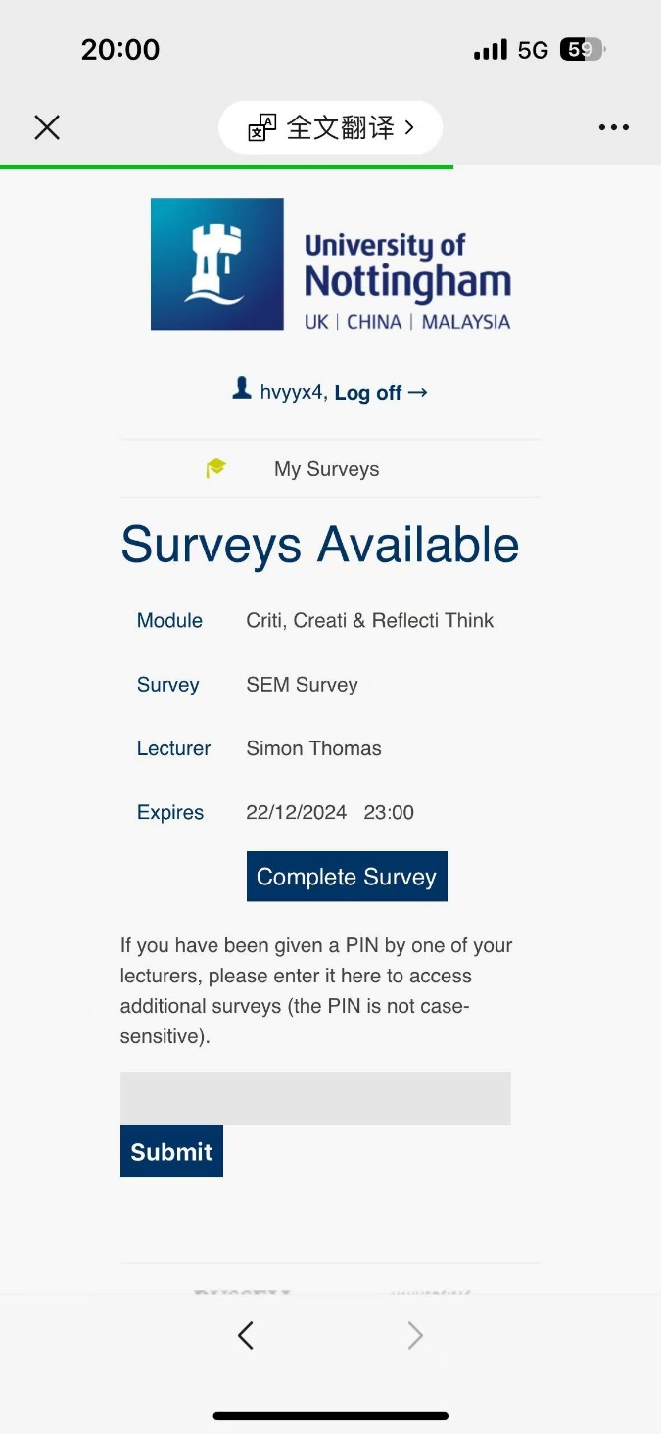
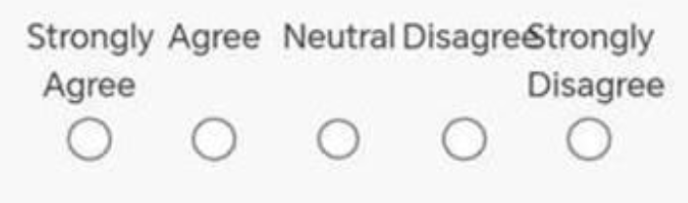
Student Evaluation of the Teacher (SET)
https://bluecastle-cn-surveys.nottingham.ac.uk
Teacher: __________
PIN number: ____________
Scan the QR code, input the PIN number and
click the Submit button.
Please read the questions and options carefully.
Focus on teaching quality and your learning experience, not on aspects such as nationality, gender or physical appearance.
Please leave comments for Q6. These should be relevant and clear.
Note: SETs are important for teachers! They are compulsory!

Slide 36
Homework
Due | Task
Weeks 11 & 12 | Prepare for your practice presentation in Week 11 or 12. Watch the full videos of the three sample presentations (in the Assessment section on Moodle). Make changes to your PPT based on your tutor’s feedback, and finalise what you want to say in your presentation. Practise delivering your presentation (possibly with note cards), and video record yourself speaking. Watch the recording and use the TEACHER practice presentation checklist from the Week 11-12 section on Moodle for self-assessment.

